Slide 1
“Smart” News
How smartphones have revolutionized the media industry
Arin Vahanian – Author, Blogger, IT Consultant

Slide 2
Agenda
How the media industry is changing
Similarities between the music and media industries
The emergence of smartphones
How news is delivered on smartphones
Examples of news apps
How consumers and the media industry can benefit
Conclusion
“Content isn’t king. Context is king.” – Alan M. Webber, Cofounder, FastCompany magazine

Slide 3
How the media industry is changing
Trends:
More and more information is available out there
Millions of new “publishers” (blogs, Web sites, Twitter, etc.)
Decreasing print advertising revenues
Shift from print content to online/mobile content
Industry cannot rely on ads, subscriptions, and classifieds for revenue the way that it used to

Slide 4
Similarities between the music and media industries
Napster changed the music industry forever – but the industry failed to listen to consumers = industry decline (57% drop in revenue in the last 10 years in the U.S.)
The Internet changed the media industry forever – and the industry has been slow to respond = industry decline (U.S. newspaper sales down 9% in the last year alone, according to the New York Times)

Slide 5
The emergence of smartphones
Smartphone sales increased by 96% worldwide in Q3 of 2010 (Gartner)
Of the more than 400 million mobile phones sold globally, 80 million were smartphones (1 in 5 phones)
Global carrier revenue for wireless data services (excluding messaging) will grow from $108.6 billion in 2009 to $250 billion in 2014 (iSuppli)
U.S. mobile advertising market alone may be worth $2 billion in 2011 (IDC)

Slide 6
The emergence of smartphones, part 2
44% of iPhone users regularly access news content (Nielsen, Oct. 2010), even higher for iPad
36% of iPhone users polled said they had used a news app in the past 30 days (Nielsen, Sept. 2010)
Most people use their phones while in transit, while waiting, before sleeping, and after getting up (University of Colorado)
Breaking news and weather most popular forms of news consumed

Slide 7
How news is delivered on smartphones
Some apps offer push notifications (The Independent)
Can read local news by entering in postal code or using geo-location
Not very interactive
Most apps do not allow readers to post comments, so readers do not feel very engaged/involved
Mostly the same material as online (shovelware)

Slide 8
Examples of news apps
Mobimag – platform for regional publishers to provide content to readers, with ads (free)
CNN’s iPhone app (iReport feature) allows users to take photos or videos and submit ($1.99)
The Guardian’s iPhone app has offline mode and topic-based search engine ($3.99)
Zinio gives users access to thousands of magazines all over the world. Can purchase single issues or subscriptions

Slide 9
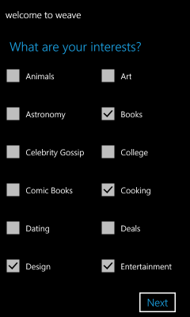
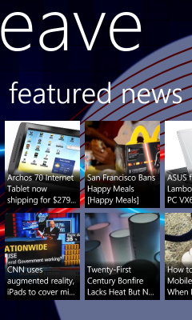
Examples of news apps, part 2
Weave

Slide 10
How consumers can benefit
Can get news anywhere, anytime (always connected)
Can get the news they want, depending on their interests and/or location
More convenient – can read the news on-the-go
More natural than reading the news on a computer
With effective advertising, can get the products and services they are interested in

Slide 11
How the media industry can benefit
Lower costs (less printing and physical distributing of materials)
More easily reach your target market
Paid-for content will work, provided it is highly specialized and offers great value
Allow transactions from within the app
More flexibility (single issues, subscriptions, and/or user donations)
Ad revenues (consumers are getting used to seeing ads in apps)

Slide 12
How the media industry can benefit – revenue streams

Slide 13
Conclusion / Recommendations
Increase interactivity
Create exclusive content
Catch users and keep them hooked
Provide a bookmarks feature
Show article lengths and estimates for reading, viewing, and listening

